Slide 1
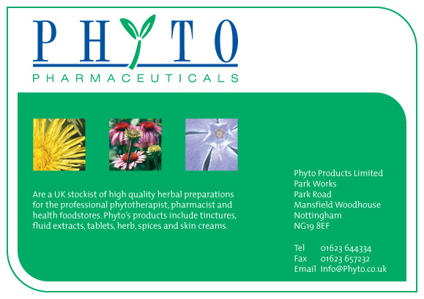

The phytochrome system

Slide 2
The Phytochrome system
Phytochromes are light-sensitive pigments found in plants.
There are two types involved in photoperiodism: P₆₆₅ (or P_{r}) and P₇₂₅ (or P_{fr})
P_{r} absorbs red light and rapidly turns to P_{fr}
P_{fr} absorbs far-red light and rapidly turns to P_{r}
In the dark, P_{fr} is slowly turned to P_{r}

Slide 3
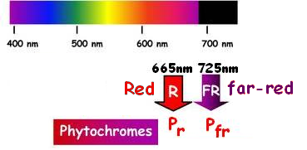
What is far-red?
Red light has wavelength around 665 nanometres,
Far red waves are longer – about 725nm

Slide 4
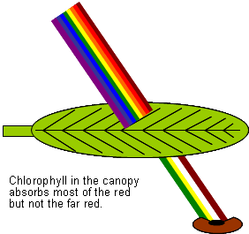
There is more red than far-red light in sunlight.
Red light is filtered out as it passes through the canopy, leaving far-red light.

Slide 5
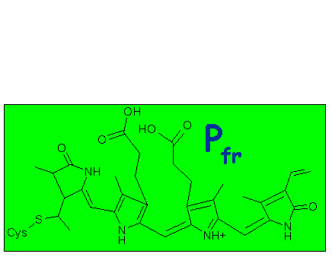
Rapid Changes in red or far-red light

Slide 6
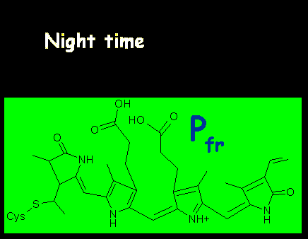
Slow change overnight
Pfr will change back to Pr in the dark
It takes a few hours for all of it to be changed and depends on temperature.

Slide 7
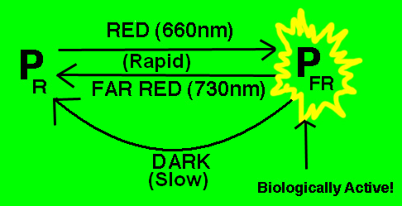
Summary

Slide 8
P_{fr/725} is the ‘biologically active’ form. It is involved in control of:
Seed germination
Stomatal opening
Flowering
Leaf fall
Leaf sleep movements
Pigment formation in fruit
Leaf expansion

Slide 9
Flowering
Phytochrome tells a plant when it gets light or when it gets dark.
Night length is measured by a biological clock
Pfr inhibits flowering in short day plants but induces flowering in long day plants.

Slide 10
Florigen
The biological clock/phytochrome system works together to cause flowering at the appropriate time of year.
It was hypothesised that a chemical message (florigen), is made in leaves and stimulates flower buds to grow.
Recently an ‘FT gene’ has been found that makes a product that acts like the hypothetical florigen.

Slide 11
